Slide 1
The Day of His Power – Casting Out Mindsets
Adrian Liew
19/08/2018

Slide 2
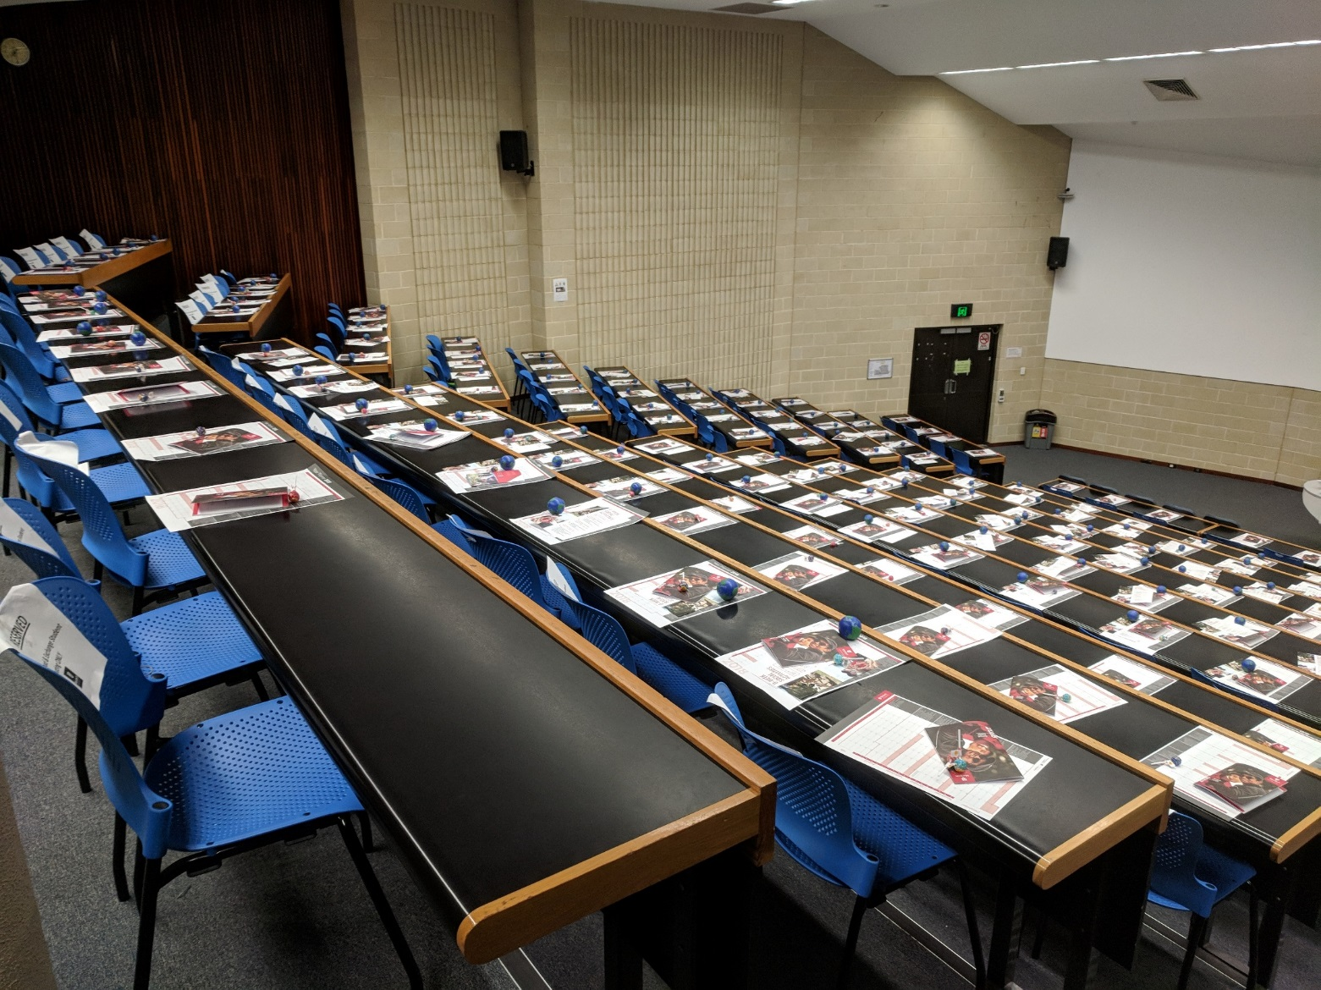
Agents of Change

Slide 3
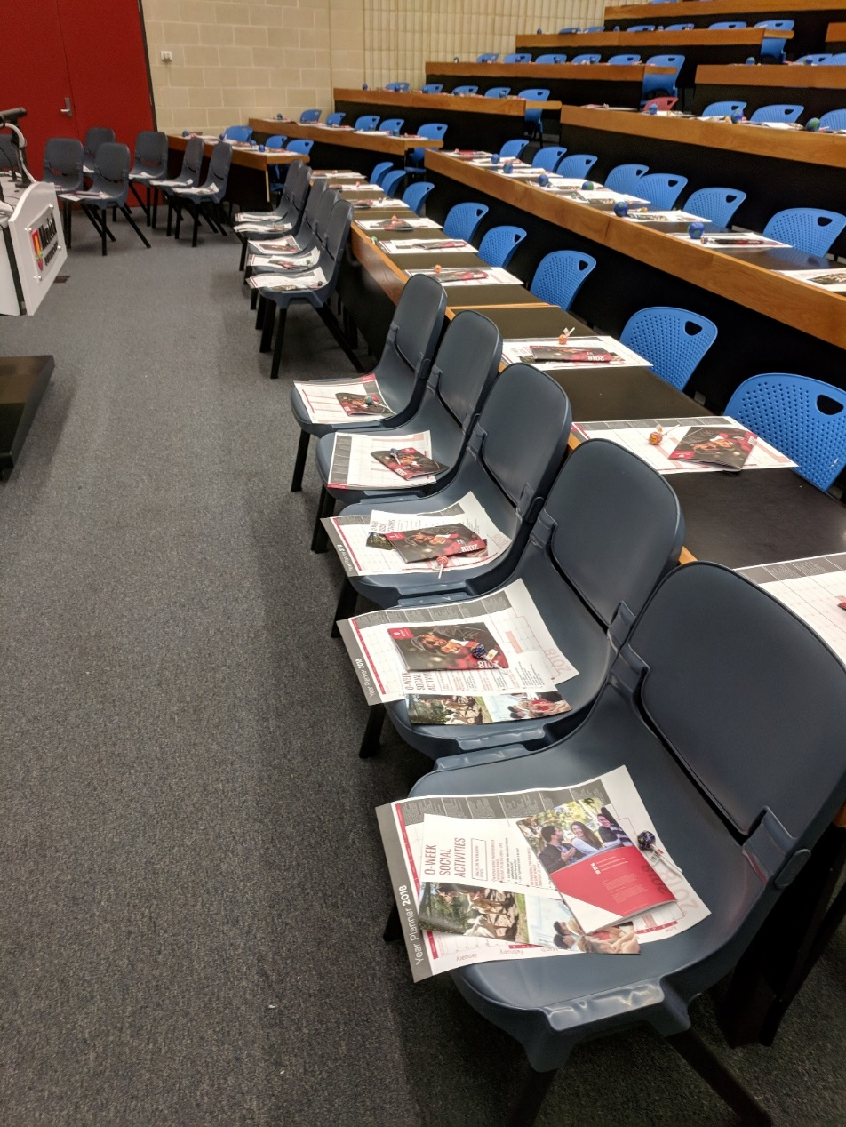
Agents of Change

Slide 4
Agents of Change
If God is going to use us to bring about change, He often begins working that
in us first

Slide 5
Key Text
2 Corinthians 10:3-5
For though we walk in the flesh, we do not war according to the flesh. For the weapons of our warfare are not carnal but mighty in God for pulling down strongholds, casting down arguments (imaginations, human reasonings) and every high thing that exalts itself against the knowledge of God, bringing every thought into captivity to the obedience of Christ

Slide 6
Key Thoughts
One wrong thought or mindset can literally keep us from our destiny - and can make us hinder others from their destiny.
If our thoughts are not yielded to God, I can end up being at war with God’s purposes

Slide 7
What Are Strongholds?
It’s a lie that satan establishes in our thinking, it is a statement that we count on as true even though it is false. It’s a mindset.

Slide 8

1) Cast out the spirit of ‘Retirement’
It’s a lie that satan establishes in our thinking, it is a statement that we count on as true even though it is false. It’s a mindset.

Slide 9
1) Cast out the spirit of ‘Retirement’
Joshua 14:6-15
6 Now the people of Judah approached Joshua at Gilgal, and Caleb son of Jephunneh the Kenizzite said to him, “You know what the Lord said to Moses the man of God at Kadesh Barnea about you and me. 7 I was forty years old when Moses the servant of the Lord sent me from Kadesh Barnea to explore the land. And I brought him back a report according to my convictions, 8 but my fellow Israelites who went up with me made the hearts of the people melt in fear. I, however, followed the Lord my God wholeheartedly. 9 So on that day Moses swore to me, ‘The land on which your feet have walked will be your inheritance and that of your children forever, because you have followed the Lord my God wholeheartedly.’

Slide 10
1) Cast out the spirit of ‘Retirement’
10 “Now then, just as the Lord promised, he has kept me alive for forty-five years since the time he said this to Moses, while Israel moved about in the wilderness. So here I am today, eighty-five years old! 11 I am still as strong today as the day Moses sent me out; I’m just as vigorous to go out to battle now as I was then. 12 Now give me this hill country that the Lord promised me that day. You yourself heard then that the Anakites were there and their cities were large and fortified, but, the Lord helping me, I will drive them out just as he said.”

Slide 11
1) Cast out the spirit of ‘Retirement’
13 Then Joshua blessed Caleb son of Jephunneh and gave him Hebron as his inheritance. 14 So Hebron has belonged to Caleb son of Jephunneh the Kenizzite ever since, because he followed the Lord, the God of Israel, wholeheartedly. 15 (Hebron used to be called Kiriath Arba after Arba, who was the greatest man among the Anakites.)
Then the land had rest from war.

Slide 12

1) Cast out the spirit of ‘Retirement’
Say YES to the Holy Spirit Fire!

Slide 13
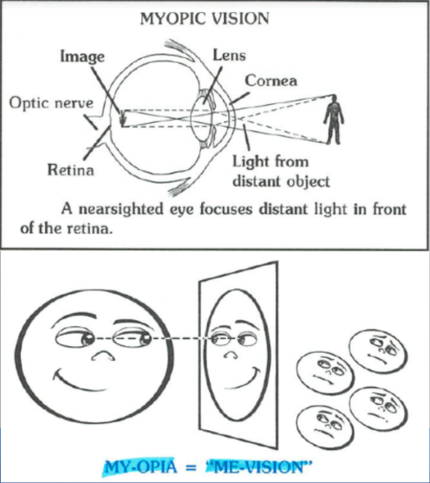
2) Cast out the spirit of Apathy
Apathy: Lack of interest, enthusiasm, or concern.

Slide 14
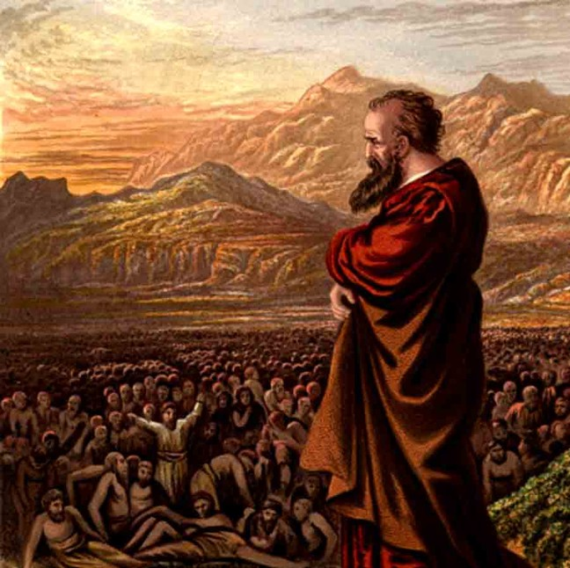
2) Cast out the spirit of Apathy
Ezekiel 22:30-31
“I looked for someone among them who would build up the wall and stand before me in the gap on behalf of the land so I would not have to destroy it, but I found no one. So I will pour out my wrath on them and consume them with my fiery anger, bringing down on their own heads all they have done, declares the Sovereign Lord.”

Slide 15
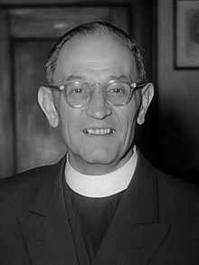
2) Cast out the spirit of Apathy
“First they came for the Socialists,
and I did not speak out—
Because I was not a Socialist.
Then they came for the Trade Unionists,
and I did not speak out—
Because I was not a Trade Unionist.
Then they came for the Jews,
and I did not speak out—
Because I was not a Jew.
Then they came for me—and there was no one left to speak for me.
Martin Niemöller

Slide 16
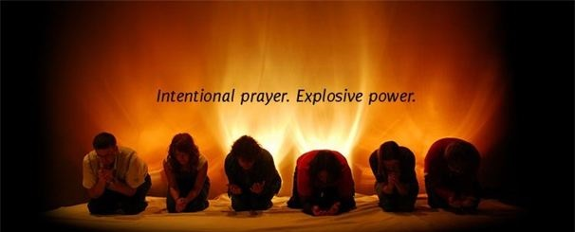
2) Cast out the spirit of Apathy
Say YES to Standing in the Gap!

Slide 17
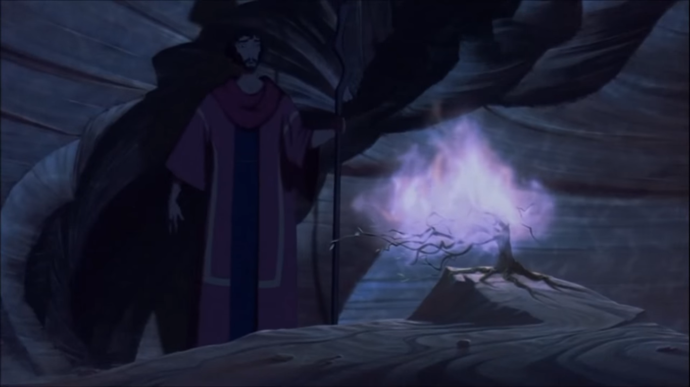
3) Cast out the Familiar Spirits
It’s often been said that Moses knew the ways of God, but the Children of Israel only knew the acts of God.

Slide 18
3) Cast out the Familiar Spirits
When God does a miracle in our lives, He’s inviting us to lean in and make a covenant with Him, because He’s revealing another aspect about who He is.

Slide 19
3) Cast out the Familiar Spirits
Say YES to Know Him!

Slide 20
Conclusion
Declare
Cast out the Spirit of Retirement
Cast out the Spirit of Apathy
Cast out Familiar Spirits
I want more of the Holy Spirit Fire
I will stand in the Gap
I want to know Him More

